Slide 1






Breaking Language Barriers in Healthcare: A Multilingual AI for Early-Stage Diabetes Risk Prediction
By:
Mikre Getu Mihrete
Hana Mekonen Tamiru
Abeshu Kebede Kelbesa
Eden Habtetsion Gebremedhin
Yared Zenebe Zewde
June 17, 2025

Slide 2

Outline
Concept note and implementation plan
Background
Objectives
SDG Relation
Data
Data Collection
Exploratory Data Analysis et Feature Engineering
Model
Model Selection and Training
Model Evaluation and Hyperparameter Tuning
Model Refinement and Testing
Results
Evaluation Results
Deployment
Future Work

Slide 3
Concept note and Implementation Plan

Slide 4
Background
Prediabetes affects 1 in 3 adults worldwide; 90% are unaware, risking progression to Type 2 diabetes and severe complications.
In Ethiopia, approximately 4.4% of adults (around 2.3 million people) live with diabetes, with 5.7% unaware of their condition, higher than the African average (3.9%).
Existing diabetes risk predictors (e.g., FINDRISC, QDiabetes) are primarily English-only, neglecting over 1 billion non-native English speakers.
This creates a profound linguistic barrier and lacks cultural relevance in health assessments, hindering early detection, especially in linguistically diverse regions like Ethiopia.

Slide 5
Objectives
Develop a multilingual system using ML to predict early-stage diabetes risk in 10 languages.
Make screening accessible, interpretable, and actionable for underserved populations.
Integrate individual health data & demographics to enhance accessibility and awareness.
Provide risk prediction without requiring expensive laboratory tests.
Offer culturally adapted symptom descriptions for clarity and accurate interpretation.

Slide 6


SDG Relation
Contributes to SDG 3 (Good Health and Well-Being): Facilitates early detection and prevention of diabetes, reducing healthcare burdens.
Aligns with SDG 10 (Reduced Inequalities): Ensures vital health information is accessible to non-English speakers through multilingual support.
Empowers underserved communities with personalized health insights in their native languages, fostering inclusive digital health.
Add your SDG image here

Slide 7
Data

Slide 8
Data Collection
Dataset Source: UCI Early-Stage Diabetes Risk Prediction Dataset (520 patient records, 17 features).
Features: Demographic (age, gender) and symptom-related (polyuria, polydipsia, sudden weight loss, etc.).
Target: Diabetes risk (Positive/Negative)
Preprocessing: Meticulously cleaned, encoded 'Yes'/'No' to 1/0, no missing values.
Due to class imbalance in the training set (256 positives and 160 negatives), we used RandomOverSampler to balance the training data (256 positives and 256 negatives after oversampling).
Key Challenge/Differentiator: Language expansion and cultural adaptation; translated questionnaires into 10 languages using professional translators.

Slide 9
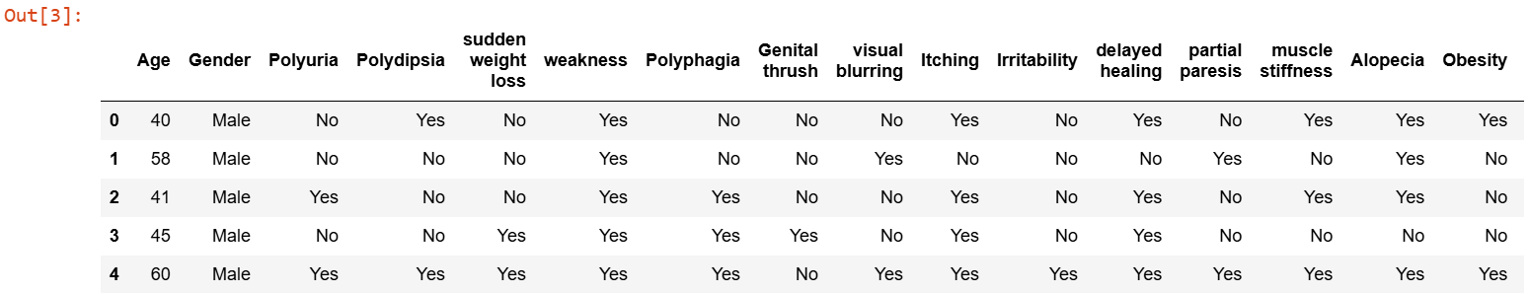
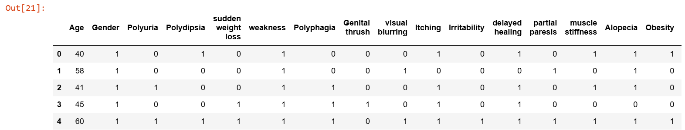
….. Cont’d
Sample of the original dataset before data transformation
Sample of the dataset after categorical transformation

Slide 10
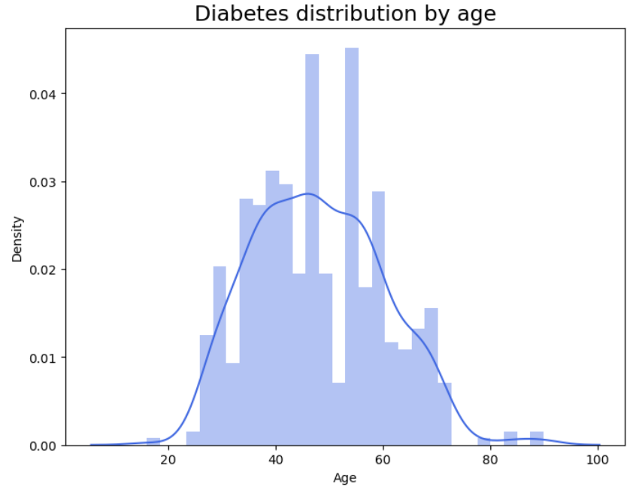
Exploratory Data Analysis and Feature Engineering
Age Distribution: Bimodal peaks around 40 and 60 years, suggesting increased susceptibility.
Feature Selection: Chi-squared (χ2) test identified top predictive symptoms.
Top Indicators: Polydipsia (excessive thirst), Polyuria (frequent urination), and Sudden Weight Loss emerged as strongest indicators of diabetes risk.

Slide 11
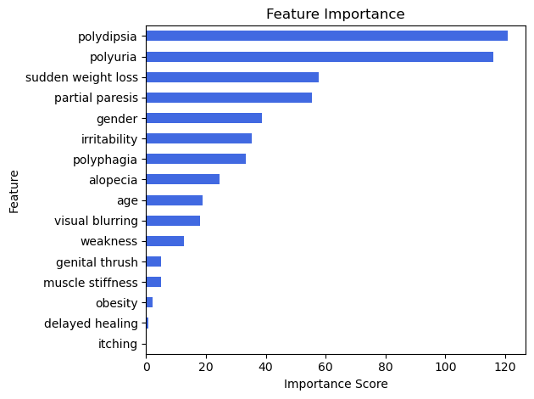
….. Cont’d
Feature importance visualization

Slide 12
Model

Slide 13
Model Selection and Training
Data Split: 80% train / 20% test split, stratified to preserve class balance.
Trained a diverse suite of ten supervised classifiers.
Models included Logistic Regression, Linear Discriminant Analysis, Gaussian Naive Bayes, K-Nearest Neighbors, Decision Tree, Random Forest, AdaBoost, Linear SVM, XGBoost, and Multilayer Perceptron.
Employed stratified 10-fold cross-validation to gauge out-of-sample performance.
Identified the Random Forest Classifier as the top-performing model.

Slide 14
Parameters including n_estimators, max_depth, and min_samples_split were fine-tuned. The optimized parameters were: n_estimators = 1000, max_depth = 16, min_samples_split = 10.
Parameters Fine-tuned: n_estimators, max_depth, min_samples_split Tuned Values: n_estimators = 1000, max_depth = 16, min_samples_split = 10
Parameters including n_estimators, max_depth, and min_samples_split were fine-tuned. The optimized parameters were: n_estimators = 1000, max_depth = 16, min_samples_split = 10.
Model Evaluation and Hyperparameter Tuning
Evaluated models using 5 metrics: Accuracy, Precision, Recall, F1-Score, and ROC AUC.
Systematic hyperparameter tuning using RandomizedSearchCV for RFC with tunable parameters.
Parameters Fine-tuned: n_estimators, max_depth, min_samples_split
Tuned Values: n_estimators = 1000, max_depth = 16, min_samples_split = 10.

Slide 15
Model Refinement and Testing
Cultural refinement: Validated symptom translations (e.g., "polyuria" in Amharic), addressed dialect nuances (e.g., "blurred vision" in Tigrigna))
Technical refinement: RTL(Right-to-Left) language UI adaptation (e.g., Arabic)
Testing: 99.04% accuracy / 100% AUC on final 20% test set
Real-world validation: Minimal false negatives in confusion matrix

Slide 16
Results

Slide 17
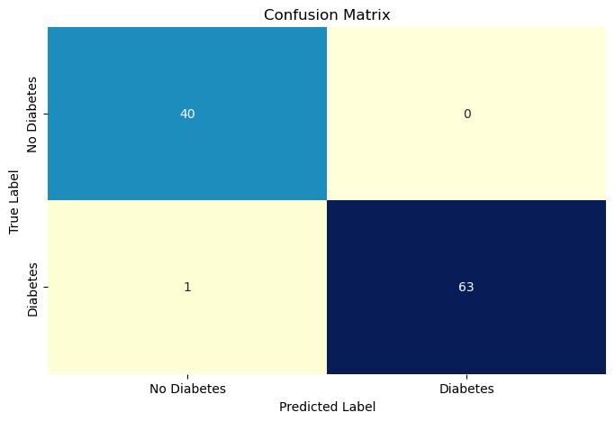
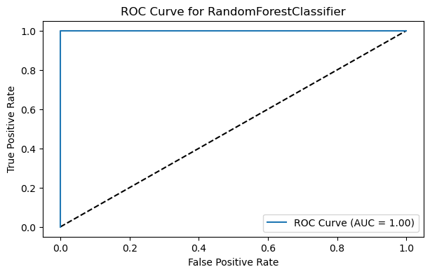
Evaluation Results
Confusion matrix demonstrates high accuracy with very few misclassifications.
The final tuned Random Forest Classifier achieved a remarkable 99.04% accuracy and an AUC of 100%.
The result indicates near-perfect discrimination between positive and negative diabetes.

Slide 18
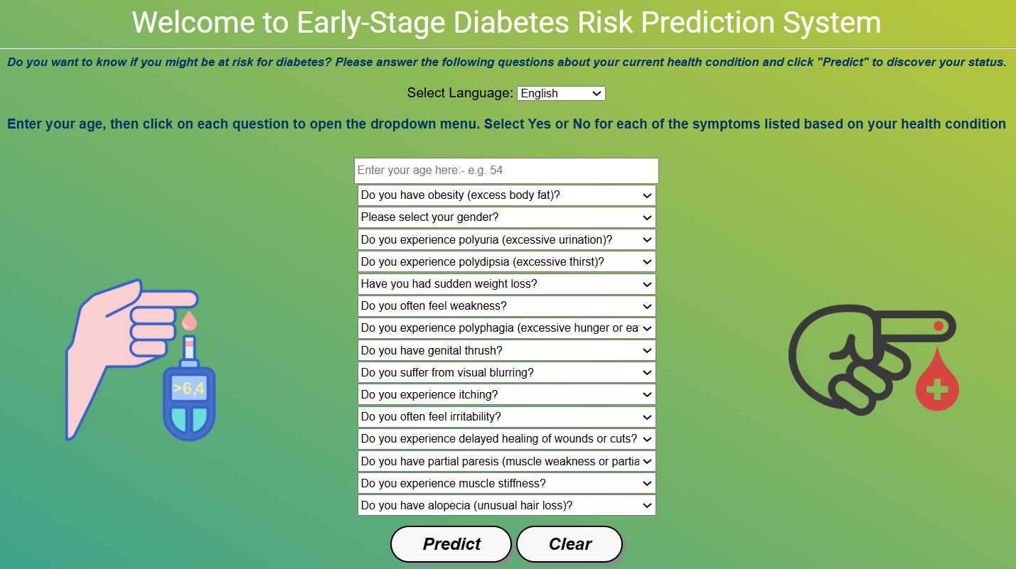
Deployment
Developed a user-friendly web application for global accessibility.
Tech Stack: Flask (Frontend/Backend), HTML, JavaScript, CSS for interactive UI.
Translation: Pre-translated dictionary-based approach with rigorous manual validation for medical terms, ensuring linguistic accuracy and cultural relevance.
User Flow: Select language -> Input age/gender/symptoms -> Instant risk prediction with explanation.
Multilingual Support: Supports 10 languages: Afar, Afan Oromo, Amharic, Arabic, Chinese, English, French, Hindi, Somali, Tigrigna
Screenshot of the deployed Multilingual AI Diabetes Risk Prediction System

Slide 19
Future Work
Enhanced Accessibility: Dedicated mobile applications, voice input functionalities for low-literacy users.
Advanced Model Development: Explore deep learning architectures, integrate Explainable AI (XAI) for deeper insights.
Real-World Integration & Validation: Implement in clinical settings, rigorous validation through clinical trials, integration with healthcare systems.
Broader Language & Data Scope: Include more dialects, ethical integration of external data.
Feedback Loop Mechanisms: Design system for user feedback to continuously improve the model.

Slide 20
References
J. B. Echouffo-Tcheugui et al., “Diagnosis and Management of Prediabetes: A Review,” JAMA, 2023.
U. Hostalek, “Global epidemiology of prediabetes - present and future perspectives,” Clin. Diabetes Endocrinol., 2019.
“Report on the Global Distribution of Native and Non-Native English Speakers.” Accessed: Jun. 15, 2025.
UCI, “Early Stage Diabetes Risk Prediction.” UCI Machine Learning Repository, 2020.
International Diabetes Federation. (2024). Ethiopia country profile. IDF Diabetes Atlas, 11th edition.
International Diabetes Federation. (2025). Global diabetes prevalence and projections. IDF Diabetes Atlas, 10th edition.
Hastie, T., Tibshirani, R., & Friedman, J. (2009). The Elements of Statistical Learning: Data Mining, Inference, and Prediction (2nd ed.). Springer.

Slide 21


Thank you!

